Slide 1
DRONE ASSISTED PUBLIC SAFETY SYSTEM
AYISHA NIDHA
ROLL NO:38

Slide 2
RELEVANCE OF THE TOPIC:
These days security is the critical concern of everyone.
The tremendous escalation in the requirement of security needs for individuals and an organization needs a proper and up-to-date surveillance system.
The existing systems are ex-pensive and complex to operate. Hence, a system that can account for insecurities regarding security and of less complexity is the need of time.

Slide 3
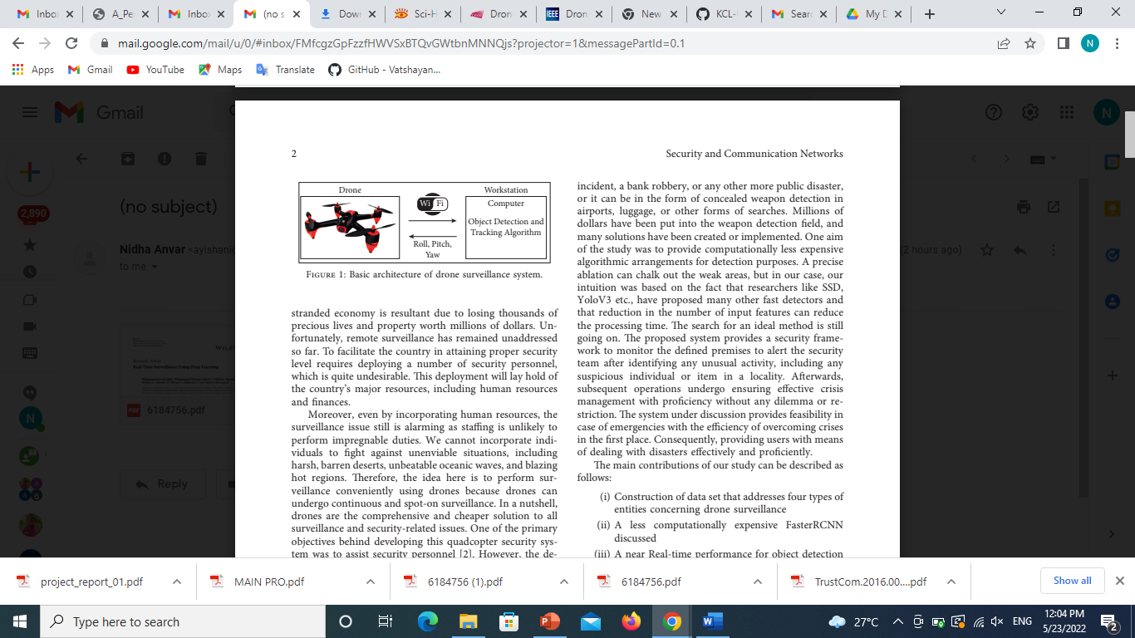
DESCRIPTION OF THE PROJECT
Many studies worked on the violence detection focus either on speed or accuracy or both but not taking into account the generality over different kind of video sources.
In this project a drone based public safety system is proposed for weapon and abnormal events detection.
The proposed model consists of CNN as a spatial
feature extractor and LSTM as temporal relation
Learning method with a focus on the three-factor
(overall generality -accuracy - fast response time).

Slide 4
OBJECTIVE
One of the most critical goals for Smart cities is law enforcement and city safety; from that goal, came the importance of surveillance systems and violence detection.
The violence in the city can happen at any time and relying on a human to monitor and detect violence event is not an efficient way to handle such cases.
The objective of this project is to implement a drone based surveilliance system to assure public safety.

Slide 5
EXISTING SYSTEM
It has been observed that the maximum number of researches have designed methodologies for learning distribution of ordinary movements from the training done using available recordings.
They have tried to identify low partable patterns and consider them as irregularities

Slide 6
PROPOSED SYSTEM
this latest system will be systematic and least prone to errors, having not as many defaults as human calculations. Human beings are more liable to cause errors than machines.
the air surveillance system is much cheaper than existing surveillance systems because the cost to deploy this system is comparatively less, and it does not involve assigning a task to human resources during surveillance because they are in-corporated with sensors and are made intelligent.
This system can also be utilized in monitoring the disaster- stricken area to assist while taking management initiatives afterwards.
The proposed technique may locate and understand human behaviour from videos taken from cameras mounted at the wall.
The proposed method consists of the detection and monitoring of any targets.

Slide 7
MODULES
The system is composed of three modules.
The detection is done using the convolutional neural networks in the to first processing module,(to sharpen the image) whereas the second
The second module manages guns and tracking.
The alarm operations are done in the last processing module.

Slide 8
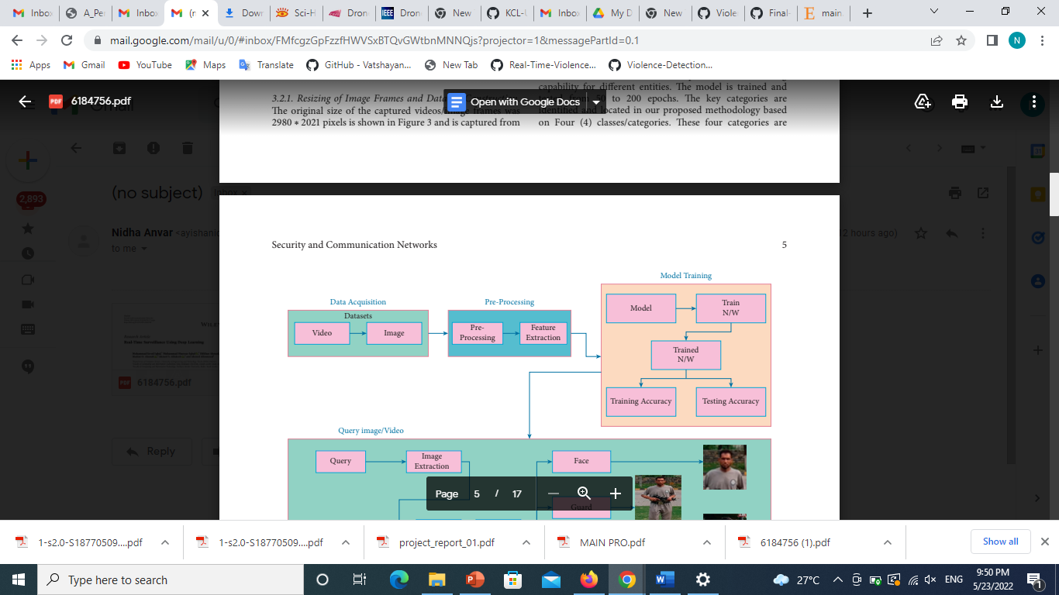
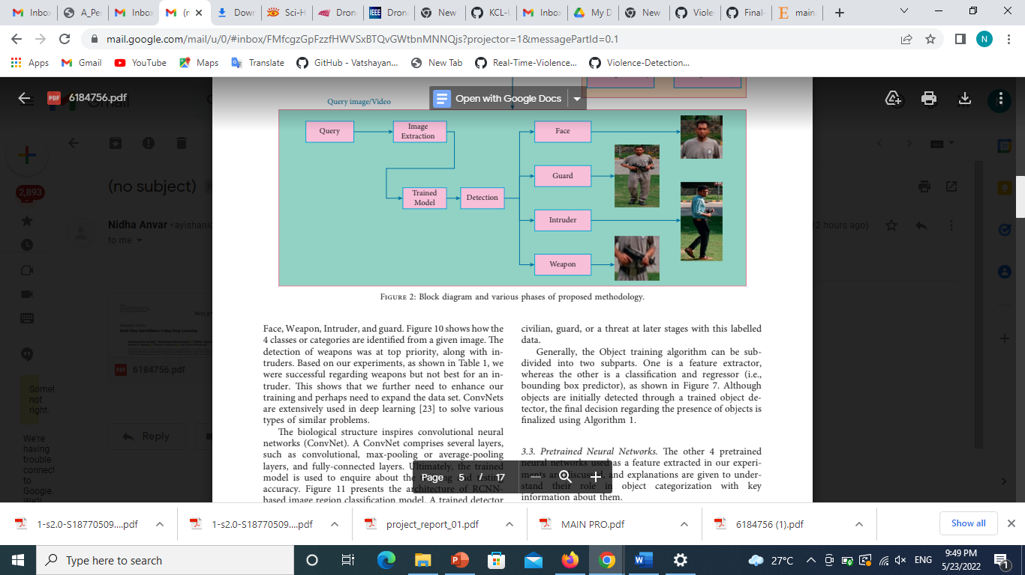
METHODOLOGY

Slide 9
FRONT END / BACK END
HTML,CSS
PYTHON

Slide 10
THANK YOU

